Slide 1
BASIC CLIENT ADD APPLICATION
Under The Trainee
By
Vaishali
SUBMIT BY
VIJAY D
EBEON0922640999

Slide 2
Technologies for Creating Dynamic Pages
SPRING BOOT APPLICATION
VS CODE
MY SQL
ANGULAR JS

Slide 3
ABSTRACT
The main objective of the Client Management System project is to have a fully automated Client Management System
This system will enable to draw the details of the client along with jobs allotted to that particular client with just a single mouse click
This Client Management System will definitely reduce the time, energy and money wasted in manually searching the details of the clients
With the help of this software, all the jobs and clients can be properly channelized

Slide 4
Existing System
The present scenario offers manual data entry. Not only this, if a client is working on multiple projects, then multiple reports are generated
A lot of time is wasted in creating the reports as well as maintaining them
This Client Management System is totally outdated and involves high risk of ambiguity and redundancy.

Slide 5
Proposed System
The proposed Client Management System is to have everything completely automated and computerized.
The software is very easy to use and manage even for a non technical person

Slide 6
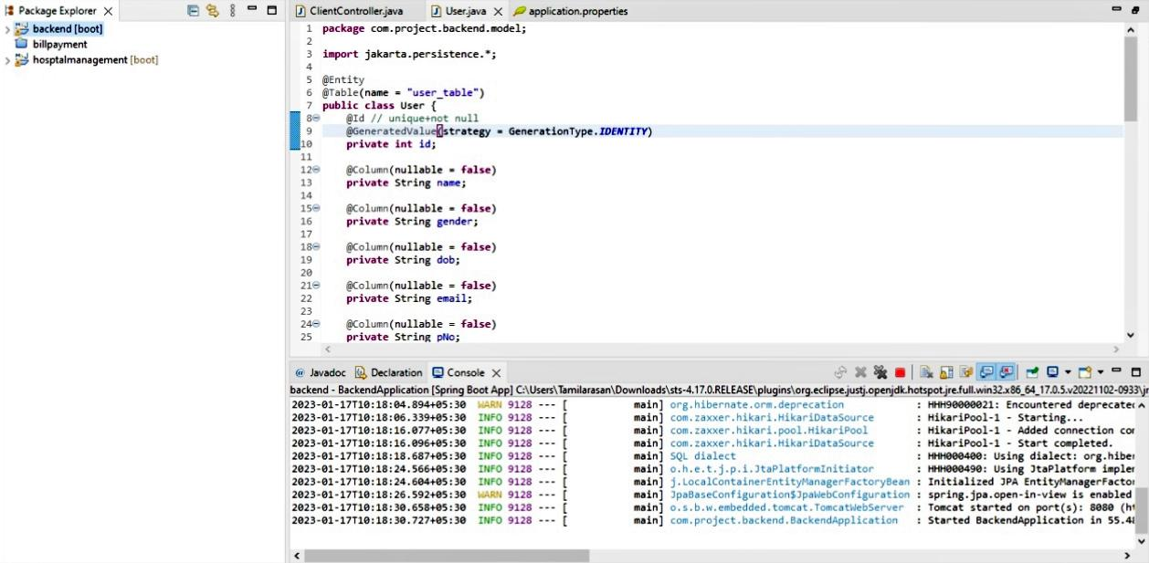
Spring boot code

Slide 7
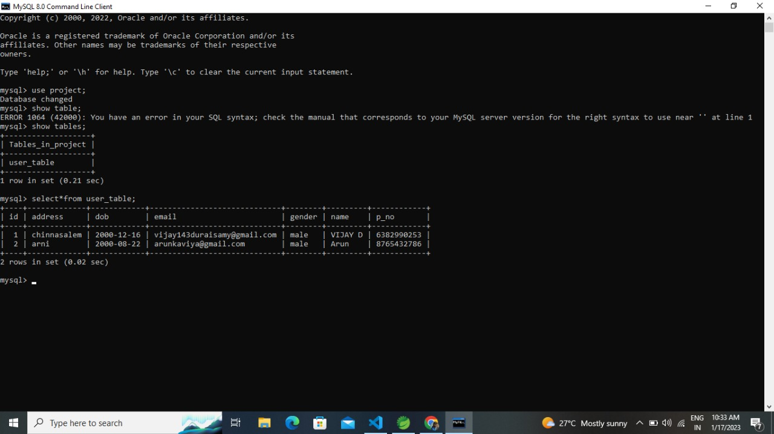
SQL database

Slide 8
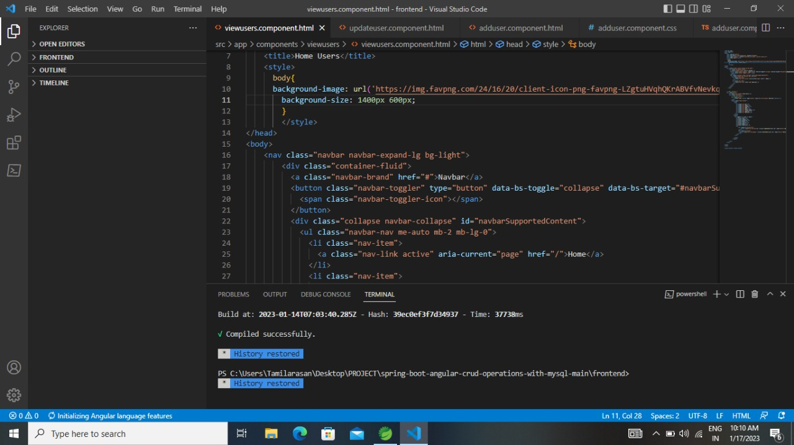
VS CODE

Slide 9
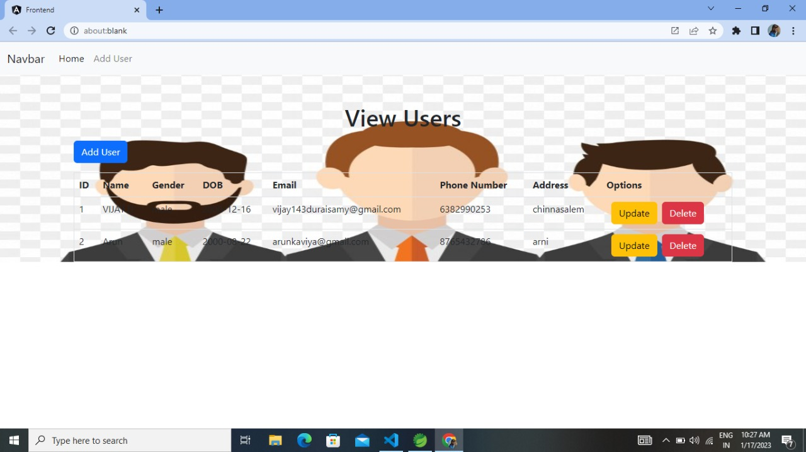
Webpage output

Slide 10
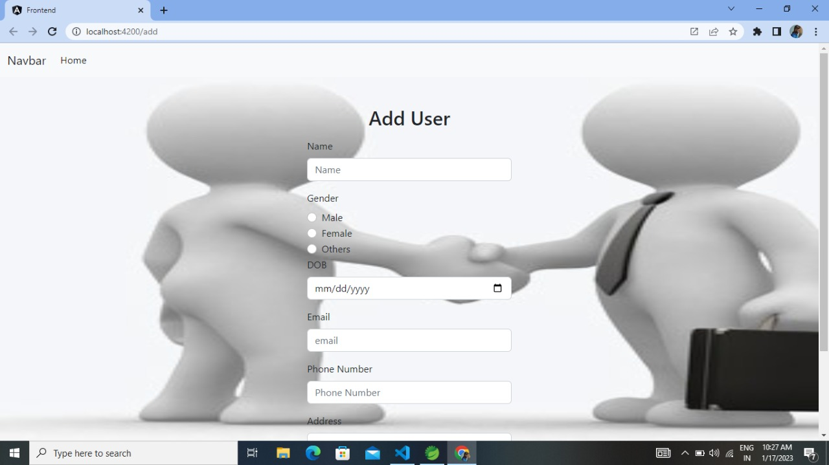

Slide 11
Conclusion
Users must have a reliable internet connection. In our project we successfully create a spring boot java project of BASIC CLIENT ADD APPLICATION. There in the project we face many issues during the creating of our project. In the end of the project we got successfully output of the project in the webserver This project mainly used to reduce the man power and increase the Technologies.

